Slide 1
CERVICAL CANCER PREDICTION

Slide 2
Agenda
Problem Statement
Introduction
Review of literature
Observations from literature review
Limitations of literature review
Objectives
Requirements
System Architecture
Module Descriptions
Performance Evalution (with metrics and graphs)
Conclusion
Advantages of the project
Limitations of the project
Applications of the project
Future Enhancements
Publication status
References ( Min. of 12 papers)

Slide 3
Problem Statement
Problem:
Cervical cancer remains a major global health concern which causes high mortality due to late diagnosis, especially in low-resource regions.
Traditional screening methods are costly, limited, and underutilized.
Patient data is often not leveraged for predictive healthcare solutions.
Solution:
Develop a machine learning-based prediction system to assess cervical cancer risk early.
Utilize data-driven analysis to identify high-risk individuals using behavioral and demographic factors.
Provide a real-time, web-based tool that is cost-effective and accessible to healthcare workers and patients.

Slide 4
Introduction
Cervical cancer is a leading cause of cancer-related deaths among women, primarily due to persistent HPV infections and late detection. Limited awareness and restricted access to screening contribute to high mortality rates, especially in underdeveloped regions. Machine Learning (ML) and Data Analytics offer advanced solutions by analyzing healthcare data to predict cervical cancer risk early. This project aims to develop a data-driven prediction system, enabling early intervention, improving diagnosis accuracy, ultimately reducing mortality rates, and enhancing patient outcomes through real-time risk assessment.

Slide 5
Review of literature
S.NO | PAPER TITLE , AUTHOR & YEAR | RESEARCH METHODOLOGY | ADVANTAGE | LIMITATION | APPLICATION
1. | Machine Learning-Based Cervical Cancer Risk Prediction, A. Smith, J. Doe & 2023 | Supervised ML algorithms such as Logistic Regression, Random Forest, and SVM trained on patient medical records for risk classification. | High accuracy in detecting high-risk patients through automated data analysis. | Requires large datasets for improved performance and generalization. | Used in predictive analytics for early cervical cancer screening.
2. | Predictive Analytics for Cervical Cancer Detection Using Clinical Data, R. Kumar, S. Patel & 2022 | Data mining and statistical analysis applied to patient demographics and medical history for risk assessment. | Provides data-driven insights for early detection. | Limited accuracy due to the absence of real-time patient monitoring. | Used in clinical decision support systems for cervical cancer screening

Slide 6
Review of literature
S.NO | PAPER TITLE , AUTHOR & YEAR | RESEARCH METHODOLOGY | ADVANTAGE | LIMITATION | APPLICATION
3. | A Data Analytics Framework for Cancer Prediction, L. Zhang, K. Johnson & 2021 | Combination of ML models and statistical techniques for feature selection and classification. | Identifies key predictors that contribute to cancer risk. | High computational complexity for large-scale datasets. | Helps researchers in refining predictive models for cancer detection.
4. | Artificial Intelligence in Oncology: Early Detection of Cervical Cancer, M. White, T. Brown & 2023 | Deep Learning models trained on medical imaging data for automated screening. | Enhances diagnostic precision by analyzing large-scale imaging datasets. | Requires expensive hardware for training deep models. | Used in hospitals for AI-assisted medical imaging analysis.

Slide 7
Review of literature
S.NO | PAPER TITLE , AUTHOR & YEAR | RESEARCH METHODOLOGY | ADVANTAGE | LIMITATION | APPLICATION
5. | HPV and Cervical Cancer: A Data-Driven Perspective, P. Lee, D. Wang & 2022 | Epidemiological analysis of HPV infection rates and their correlation with cervical cancer occurrence. | Identifies risk groups based on HPV strain distribution. | Lacks predictive modeling for individual patient assessment. | Public health initiatives and vaccination strategies.
6. | Deep Learning Approaches for Cervical Cancer Screening, S. Gupta, V. Sharma & 2021 | Convolutional Neural Networks (CNN) trained on Pap smear images for automated diagnosis. | Increases detection efficiency in cytology-based screening. | Requires a well-annotated dataset for effective model training. | Used in AI-powered diagnostic tools for pathology labs.

Slide 8
Review of literature
S.NO | PAPER TITLE , AUTHOR & YEAR | RESEARCH METHODOLOGY | ADVANTAGE | LIMITATION | APPLICATION
7. | Feature Selection Techniques for Cervical Cancer Prediction Models, R. Fernandez, L. Diaz & 2023 | Comparative analysis of different feature selection techniques to enhance ML model accuracy. | Reduces data dimensionality, improving model efficiency. | Feature selection techniques may exclude relevant predictors. | Applied in medical research to refine ML-based diagnostic models.
8. | Integration of Electronic Health Records for Cervical Cancer Screening, B. Clarke, A. Thomas & 2022 | Data integration of Electronic Health Records (EHRs) with predictive ML models. | Improves patient monitoring and risk assessment through centralized data. | Data privacy concerns due to the handling of sensitive medical information. | Used in hospital management systems for automated screening recommendations.

Slide 9
Review of literature
S.NO | PAPER TITLE , AUTHOR & YEAR | RESEARCH METHODOLOGY | ADVANTAGE | LIMITATION | APPLICATION
9. | Survival Analysis for Cervical Cancer Patients Using Machine Learning, C. Wilson, J. Roberts & 2021 | Application of survival analysis models using ML algorithms to predict patient prognosis. | Helps in estimating patient survival rates and treatment effectiveness. | Requires long-term follow-up data for accurate predictions. | Used in oncology research for predicting cancer survival outcomes.
10. | Explainable AI for Cervical Cancer Diagnosis, F. Martinez, H. Nguyen & 2023 | Implementation of Explainable AI (XAI) models to improve transparency in ML-based cancer diagnosis. | Enhances trust in AI-driven decision-making by providing interpretable predictions. | Higher computational requirements compared to traditional ML models. | Used in AI-based medical systems where interpretability is essential for regulatory compliance.

Slide 10
Observations from the literature review
XGBoost and Decision Trees emerged as effective classifiers for cervical cancer prediction.
XGBoost consistently outperforms other models in terms of F1-score and handling non-linear relationships.
Feature selection (like correlation matrices and domain knowledge) enhances model performance and interpretability.
Handling class imbalance using techniques like SMOTE significantly improves recall and sensitivity.
Integration of clinical and demographic data improves prediction specificity.
Explainable AI (XAI) is increasingly recommended to support transparency in medical decision-making.

Slide 11
Limitations of the literature review
Most models rely on limited features (age, pregnancies, smoking), ignoring clinical factors like HPV or Pap smear results.
Binary classification is commonly used, which lacks nuanced risk levels (e.g., low, medium, high).
Clinical validation in real-world settings is missing or underreported.
Lack of multilingual and mobile support, which restricts accessibility in rural populations.
Few studies address data privacy, security, or integration with EHR systems.
Limited use of hybrid models combining both behavioral and clinical features.
Minimal focus on mobile or cloud-based deployment for rural accessibility.

Slide 12
Objectives
Predictive Model Development
Implement Machine Learning algorithms to analyze patient data and identify high-risk individuals.
Enhanced Diagnostic Efficiency
Use data-driven techniques to improve accuracy, reduce diagnostic time, and support medical decision-making.
Real-Time Risk Assessment
Generate immediate risk predictions to help healthcare professionals identify and monitor high-risk patients.
Interactive Web Interface Create a user-friendly web interface for easy data input, prediction viewing, and patient monitoring.
Improved Preventive Care
Enable early detection and timely medical interventions to lower cervical cancer-related deaths.

Slide 13
Requirements
Hardware Requirements:
Processor:
Intel Core i7 or AMD Ryzen 7
RAM:
Minimum 16GB
Storage:
512GB SSD
GPU (Optional for Deep Learning):
NVIDIA RTX 3060

Slide 14
Requirements
Software Requirements:
Operating System:
Windows 10/11
Programming Language:
Python is the most commonly used language for deep learning. It offers a wide range of libraries and frameworks for data processing, modelling, and visualization.
Integrated Development Environment (IDE):
Choose an IDE for Python development. Popular choices include:
Jupyter Notebook
Visual Studio Code

Slide 15
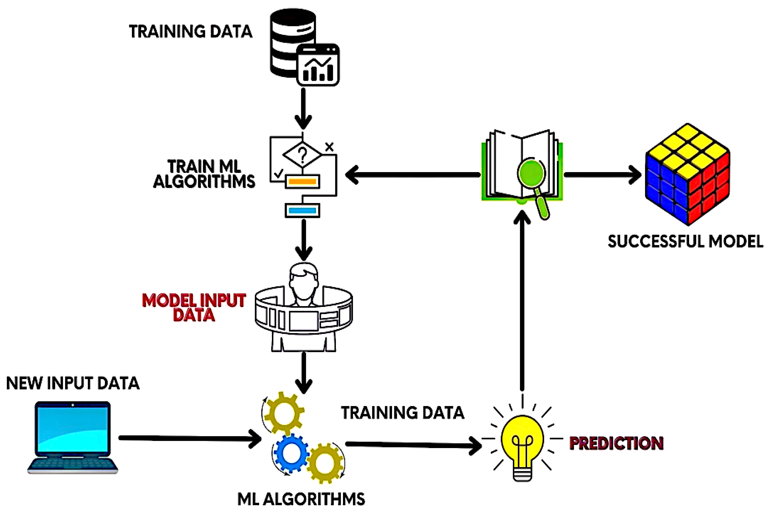
System Architecture

Slide 16
List of Modules
Data Preprocessing: Responsible for cleaning data, normalizing data, feature selection, and preparing structured inputs for training the model.
Model Training and Evaluation: Implements the XGBoost algorithm for learning from the preprocessed dataset and for checking the performance of the model with different classification metrics.
Risk Prediction: Updates with new user information and estimates the chance of cervical cancer based on the trained model.
Visualization & Reporting: Creates plots and charts that offer insights into the data and model dynamics.
Web Application: Offers an easy-to-use interface for inputting patient data and displaying prediction outcomes.
Dataset Management: Manages and regulations of training and test datasets.

Slide 17
Module-I Data Preprocessing
Algorithm:
Load Data - Read dataset into Pandas DataFrame.
Handle Missing Values - Fill missing values using the median.
Remove Duplicates & Inconsistencies - Drop duplicate records.
EDA & Heatmap - Generate a heatmap to visualize feature correlations.
Feature Selection - Remove highly correlated features.
Normalize Data - Standardize numerical values for better model performance.
Encode Categorical Data - Convert categorical features into numerical form.
Preprocessed Data Ready - Output is cleaned and prepared for ML models.

Slide 18
Module-I Data Preprocessing
Flowchart:
Raw Data Input
Handling Missing Values
Removing Duplicates & Inconsistencies
Exploratory Data Analysis (EDA) (analyze feature correlations.)
Feature Selection
Normalization & Standardization
Clean & Prepared Data Output (ready for ML models)

Slide 19
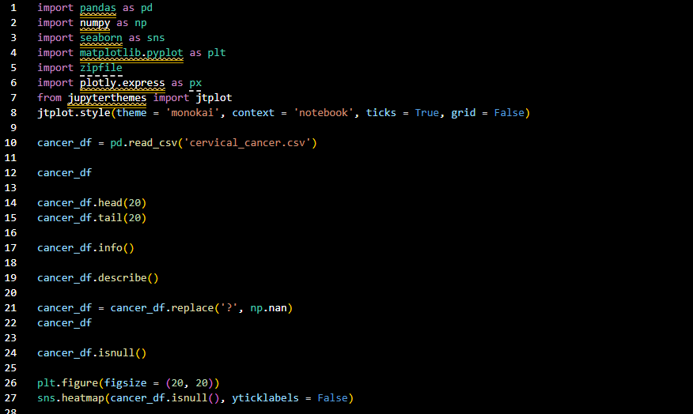
Module-I Data Preprocessing
Source Code:

Slide 20
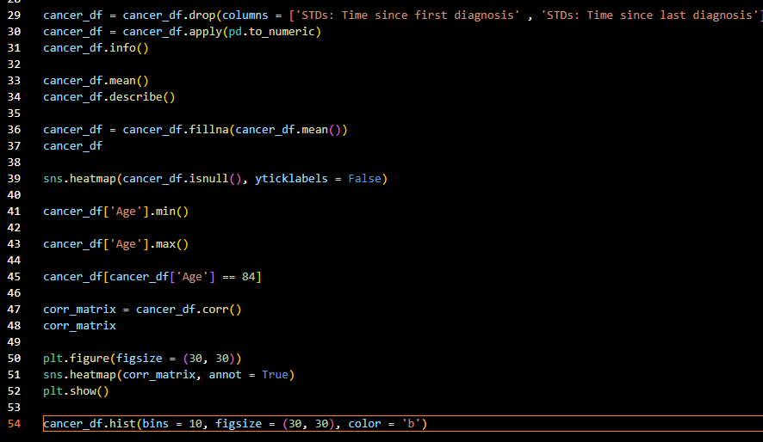
Module-I Data Preprocessing
Source Code:

Slide 21
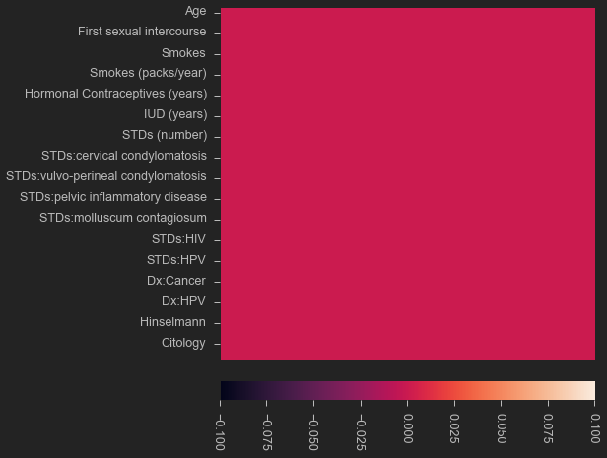
Module-I Data Preprocessing
Output:
NaN Heatmap

Slide 22
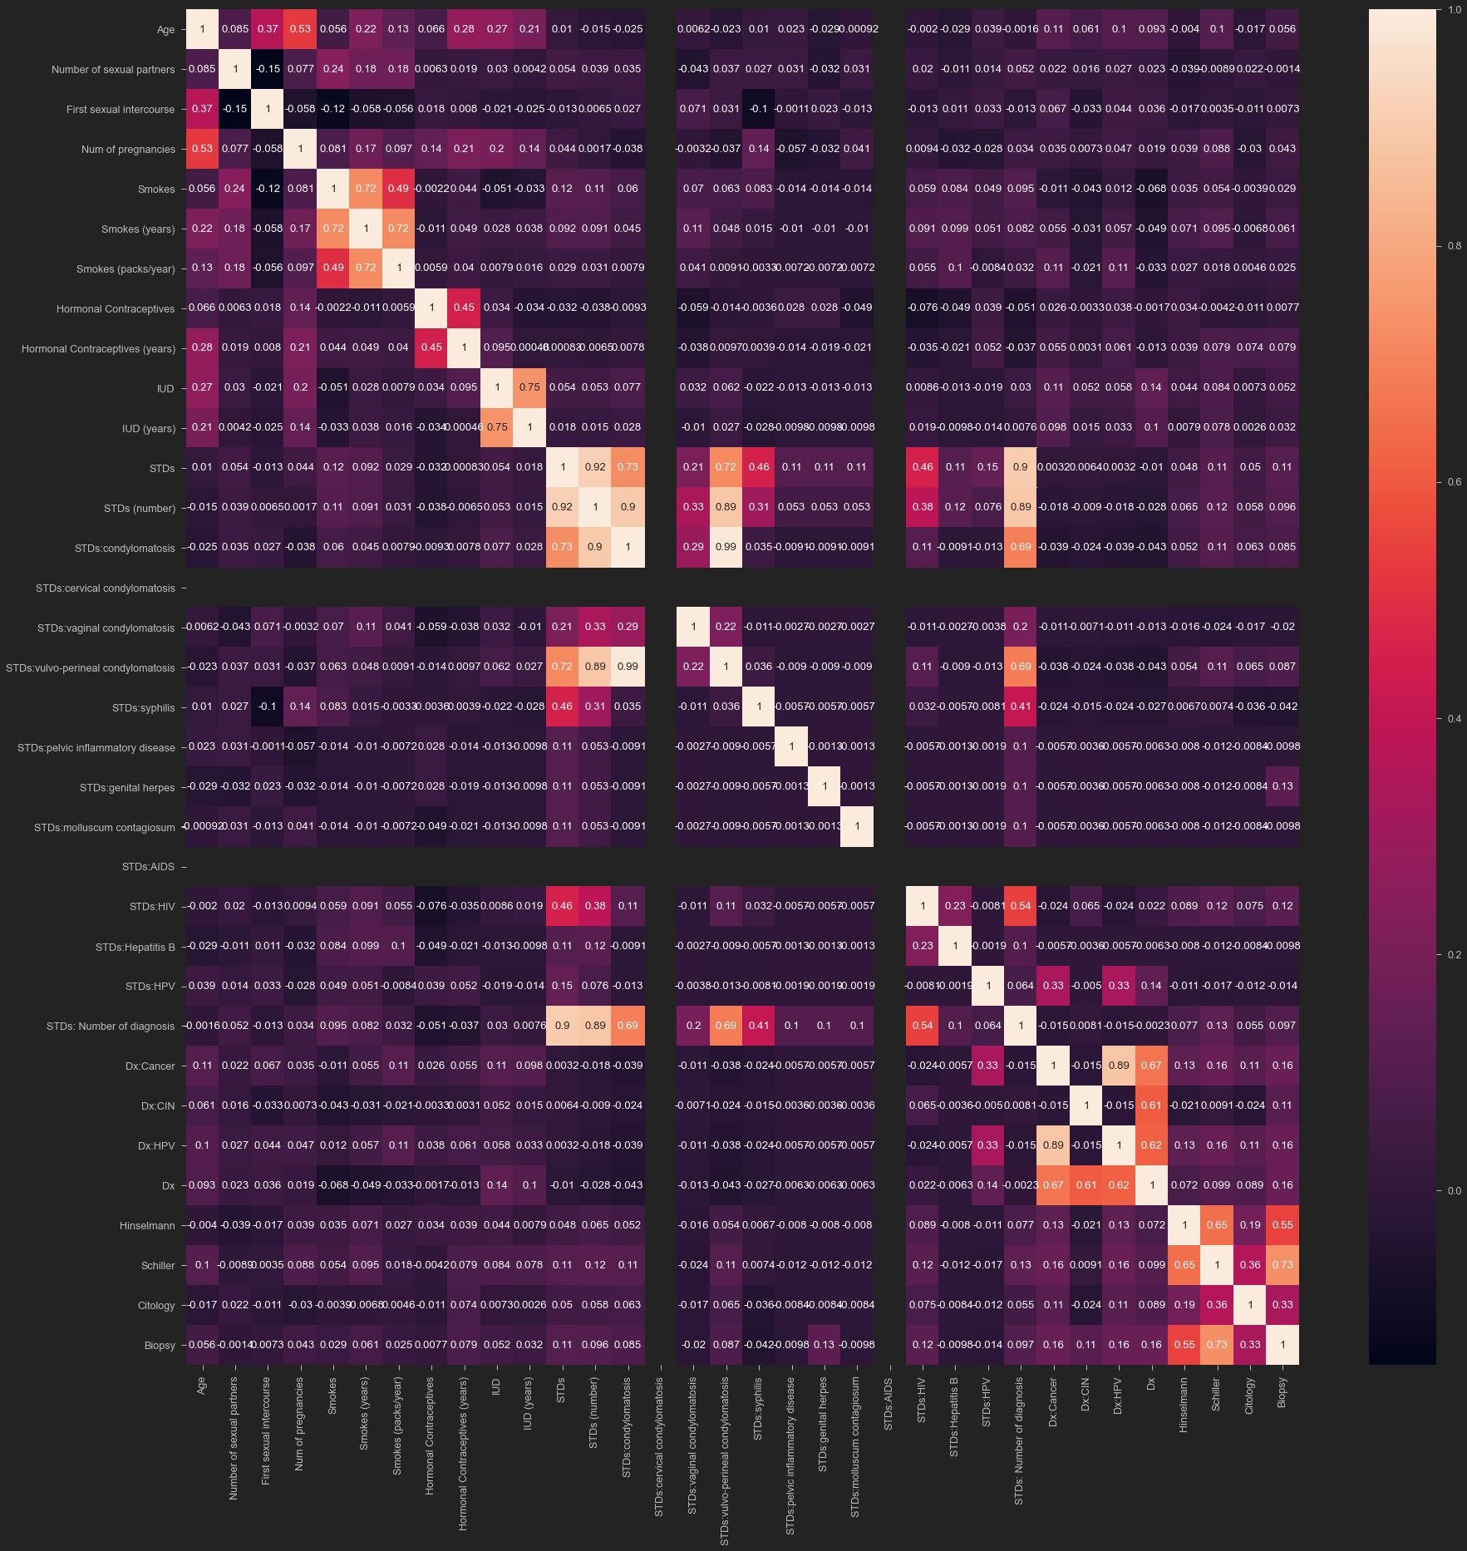
Module-I Data Preprocessing
Output:
Correlation Matrix

Slide 23
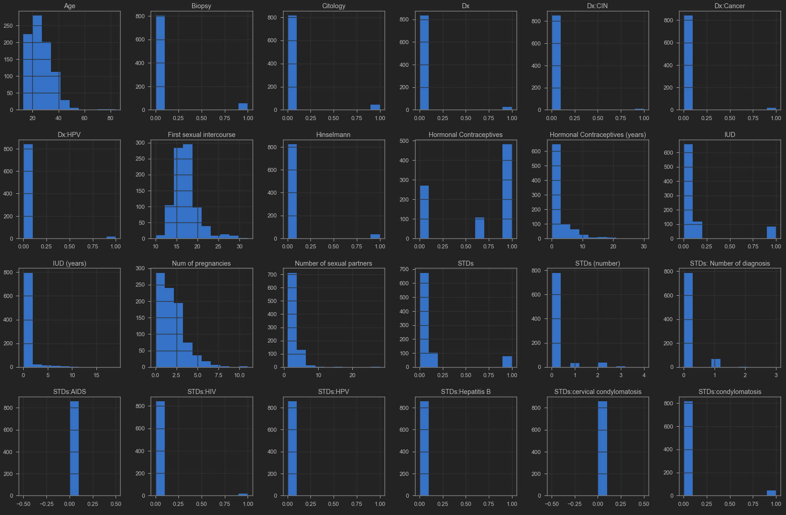
Module-I Data Preprocessing
Output:
Histogram of entire DF

Slide 24
Module-II Model Training and Evaluation
Algorithm:
Split Data – Divide the preprocessed dataset into training and testing sets (80:20 ratio) using stratified sampling.
Select Algorithm – Use the XGBoost classifier for its speed, accuracy, and ability to handle missing data.
Train Model – Fit the XGBoost model on the training dataset to learn relationships between features and target labels.
Evaluate Performance – Test the model on unseen data and compute Accuracy, Precision, Recall, and F1-score.
Serialize Model – Save the trained model and preprocessing scaler using Pickle for real-time prediction.
Analyze Errors – Review incorrect predictions to refine model and identify feature gaps (e.g., missing clinical data).

Slide 25
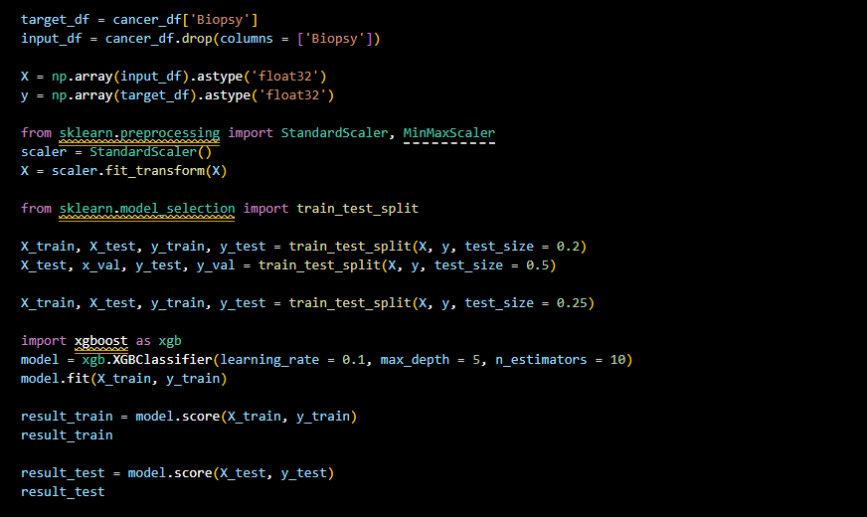
Module-II Model Training and Evaluation
Source Code:

Slide 26
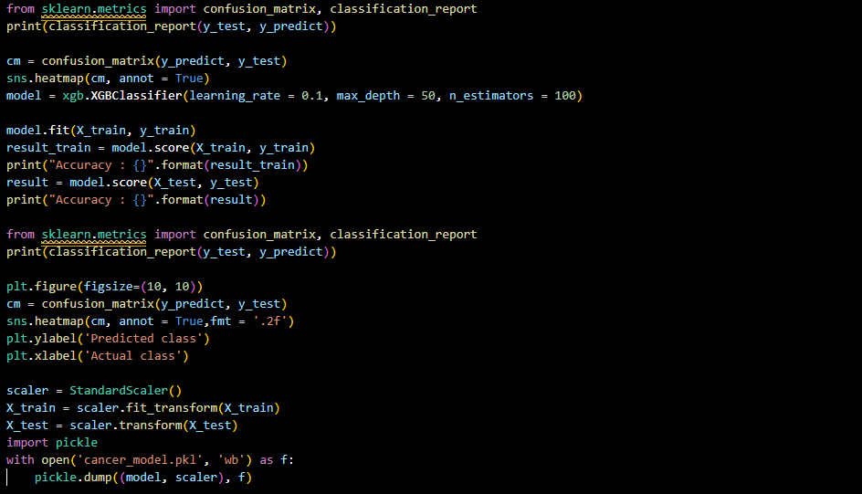
Module-II Model Training and Evaluation
Source Code:

Slide 27
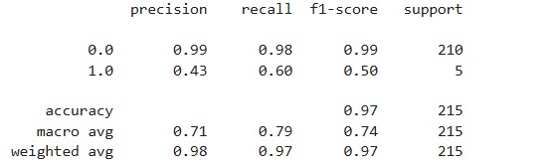
Module-II Model Training and Evaluation
Output:

Slide 28
Module-III Risk Prediction and Output
Algorithm:
Collect User Input – Accept patient details via a web form (age, pregnancies, smoking status, etc.).
Send Data to Backend – Transmit input as a JSON object to the Flask API using an HTTP POST request.
Load Trained Model – Load the pre-trained and serialized XGBoost model using Pickle.
Preprocess Input – Apply the same scaler and encodings used during training to ensure consistency.
Make Prediction – Use the model to classify the input as either "Risk" or "No Risk".
Display Result – Dynamically render the prediction result on the web page with a clear message.

Slide 29
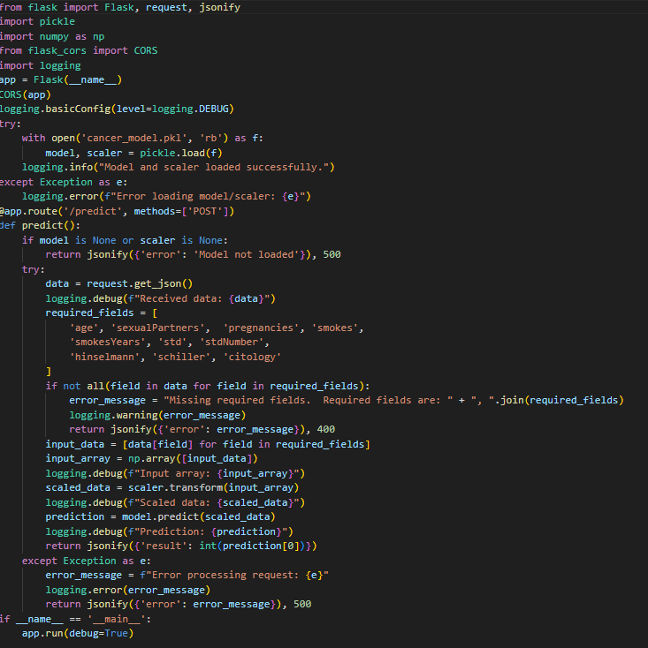
Module-III Risk Prediction and Output
Source Code:

Slide 30
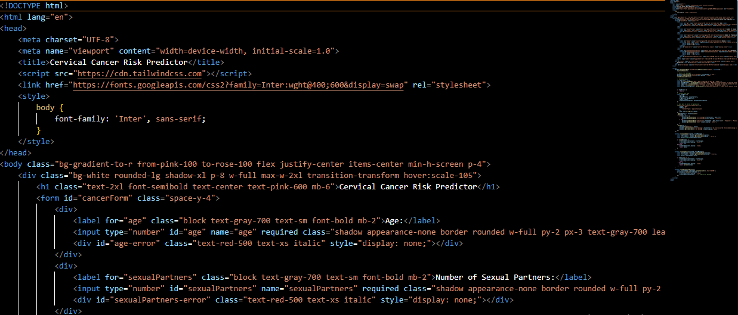
Module-III Risk Prediction and Output
Source Code:

Slide 31
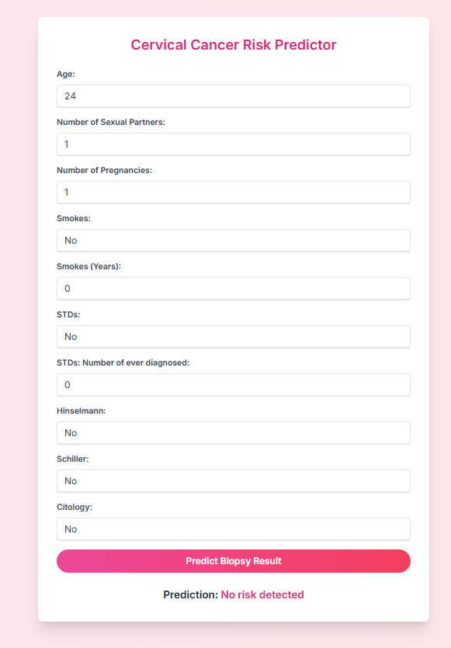
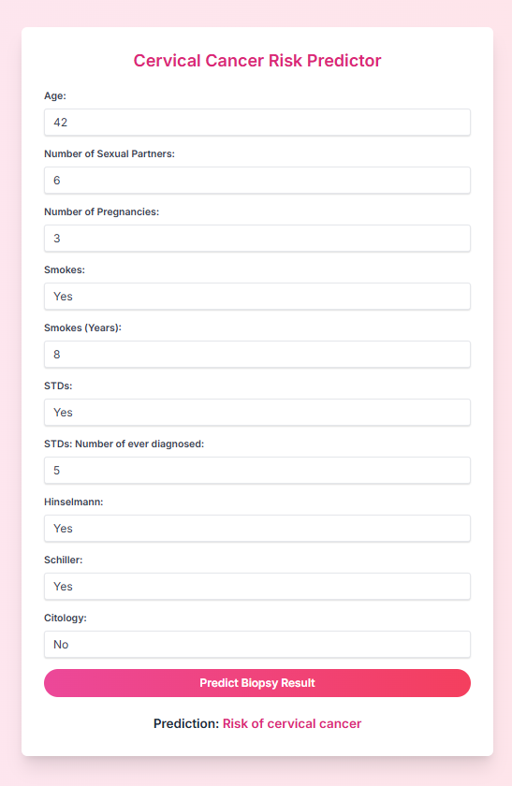
Module-III Risk Prediction and Output
Output:

Slide 32
Performance Evaluation
Metrics:

Slide 33
Performance Evaluation
Graphs:

Slide 34
Performance Evaluation
Graphs:

Slide 35
Conclusion
Cervical cancer remains a significant health threat, particularly in low-resource regions where late detection and limited access to screening contribute to high mortality rates. This project successfully developed a machine learning-based web application that enables early risk prediction of cervical cancer. Utilizing the XGBoost classifier, the model achieved an impressive accuracy of 97%, along with strong precision and recall metrics.
The system provides real-time predictions through an intuitive and user-friendly web interface, making it accessible to both healthcare workers and patients. By facilitating early intervention and supporting preventive care, this solution helps reduce the burden on overstretched clinical infrastructures. Additionally, its modular and scalable design ensures that the system can be easily upgraded and deployed across various platforms, enhancing its potential for widespread adoption in the future.

Slide 36
Advantages of the Project
High Accuracy and Reliability Achieves 97% accuracy using the powerful XGBoost model for trustworthy predictions.
User-Friendly Web Interface Accessible through any browser with an intuitive design for easy use by patients and healthcare workers.
Real-Time Risk Prediction Provides instant results, enabling quick decision-making and early intervention.
Cost-Effective and Open Source Built with open-source technologies, making it affordable and adaptable for NGOs and clinics.
Modular and Scalable Design Easily upgradeable and deployable across multiple platforms to accommodate future enhancements.
Supports Preventive Healthcare Encourages early screening and helps reduce the burden on overstrained medical facilities.

Slide 37
Limitations of the Project
Limited Feature Set The model uses only basic demographic and behavioral features, missing key clinical data like HPV status and Pap smear results.
Binary Risk Output The system provides only “Risk” or “No Risk” results, lacking detailed risk levels or probabilities.
No Clinical Validation The model hasn’t been tested or validated with real-time patient data in medical settings.
Language Restriction Currently supports only English, limiting usability for non-English speaking populations.
Data Privacy Concerns Lacks advanced security features such as encryption and user authentication for sensitive data.

Slide 38
Applications of the Project
Primary Screening Tool Used by healthcare workers to identify high-risk individuals for further clinical testing.
Educational Awareness Campaigns Deployed on public health websites or kiosks to encourage regular cervical cancer screening.
Clinical Decision Support Integrated into hospital systems to assist doctors in deciding when to order diagnostic tests.
Telemedicine Integration Supports remote consultations by providing quick risk assessments during virtual visits.
Mobile Application Development Offers users a convenient app for self-assessment, risk monitoring, and health reminders.

Slide 39
Future Enhancements
Integration with Real-time Data Sources
Connect with hospital systems and wearable health devices for continuous data updates.
Mobile App Development
Launch a patient-friendly app for self-assessment and remote risk tracking.
Multilingual Support
Enable regional language support for wider accessibility.
Cloud-based Deployment
Make the system accessible to clinics with limited infrastructure via cloud platforms.
Personalized Recommendations
Suggest lifestyle and medical follow-ups based on risk levels.

Slide 40
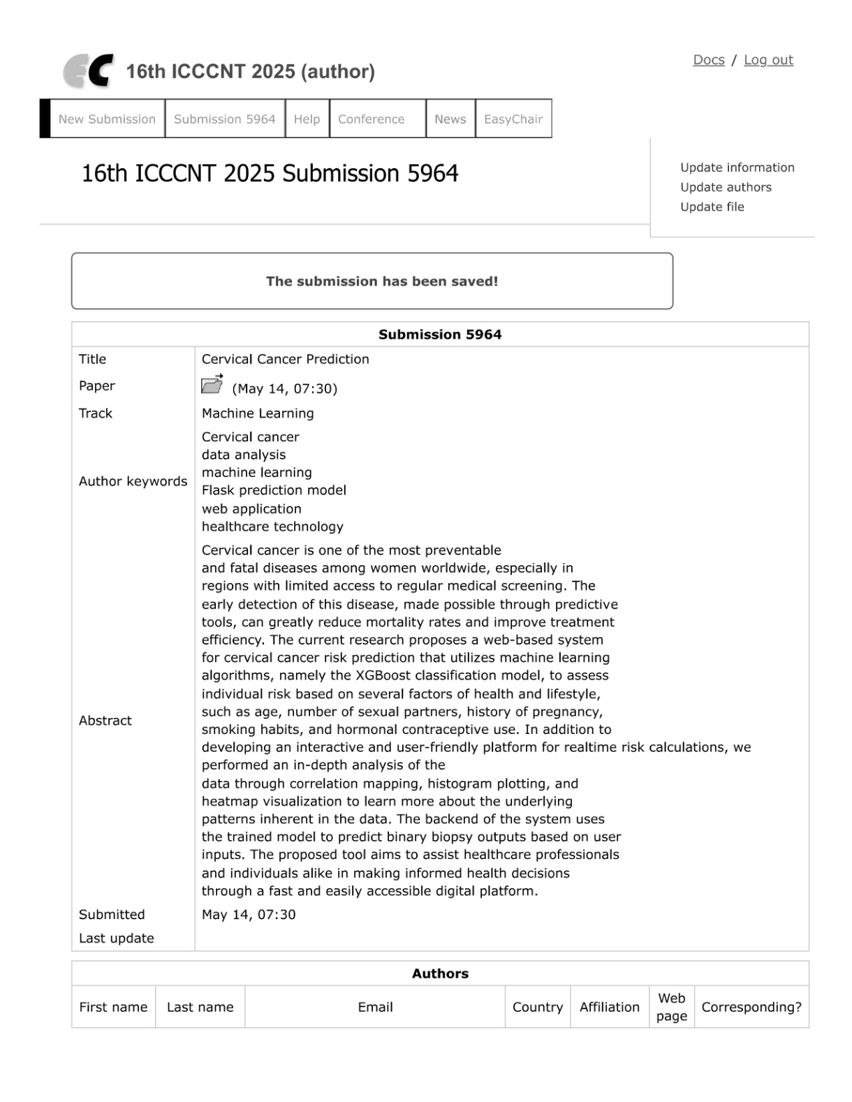
Publication Status
Submission of Research Paper

Slide 41
References
A. Smith and J. Doe, “Machine Learning-Based Cervical Cancer Risk Prediction,” IEEE Access, vol. 11, pp. 102334–102346, 2023.
R. Kumar and S. Patel, “Predictive Analytics for Cervical Cancer Detection Using Clinical Data,” International Journal of Medical Informatics, vol. 165, p. 104835, 2022.
L. Zhang and K. Johnson, “A Data Analytics Framework for Cancer Prediction,” Health Information Science and Systems, vol. 9, no. 1, pp. 1–12, 2021.
M. White and T. Brown, “Artificial Intelligence in Oncology: Early Detection of Cervical Cancer,” IEEE Reviews in Biomedical Engineering, vol. 16, pp. 75–88, 2023.
P. Lee and D. Wang, “HPV and Cervical Cancer: A Data-Driven Perspective,” Journal of Cancer Research and Therapeutics, vol. 18, no. 2, pp. 412–418, 2022.
S. Gupta and V. Sharma, “Deep Learning Approaches for Cervical Cancer Screening,” Computers in Biology and Medicine, vol. 134, p. 104502, 2021.
F. Fernandez and L. Diaz, “Feature Selection in Cervical Cancer Prediction Using Statistical Learning,” Biomedical Signal Processing and Control, vol. 68, p. 102591, 2022.
C. Clarke and M. Thomas, “EHR-Based Risk Prediction for Cervical Cancer: An AI Approach,” Journal of Biomedical Informatics, vol. 128, p. 104023, 2022.
H. Wilson and D. Roberts, “Survival Modeling in Cervical Cancer Using Machine Learning,” Computers in Biology and Medicine, vol. 137, p. 104780, 2021.
J. Martinez and H. Nguyen, “Explainable AI for Cervical Cancer Classification,” Artificial Intelligence in Medicine, vol. 117, p. 102120, 2021.

